Slide 1
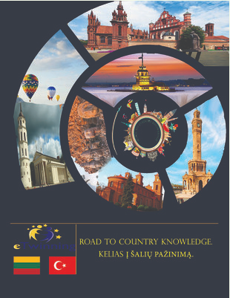
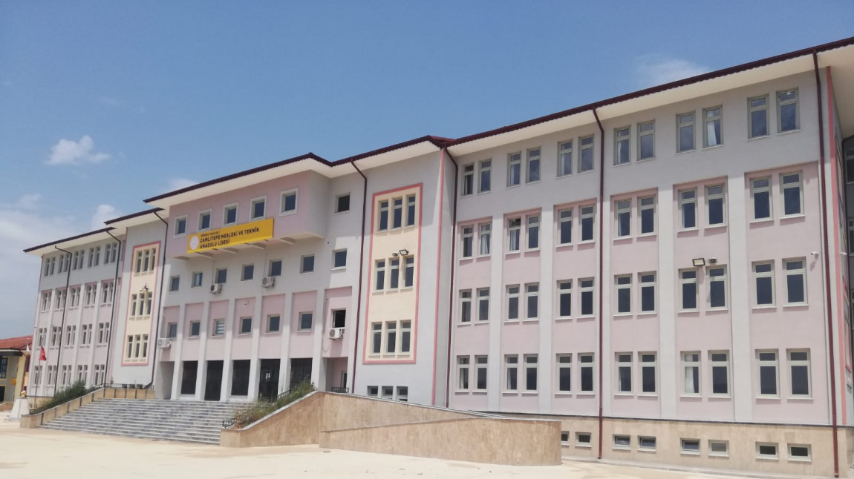
ROAD TO COUNTRY KNOWLEDGE Kocaeli/Korfez Çamlıtepe Mtal team

Slide 2
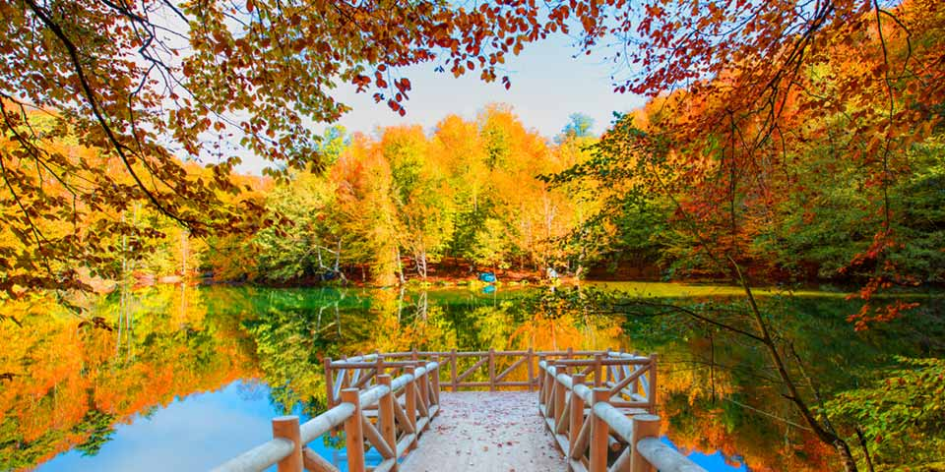
Some of Turkey's natural beauty and Nature Parks

Slide 3
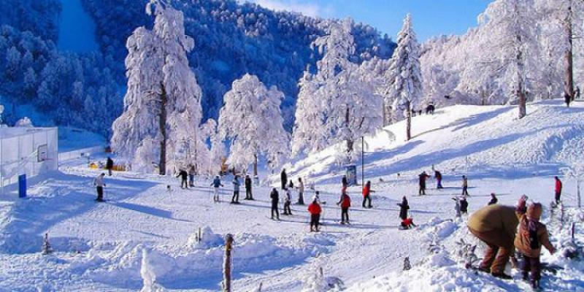
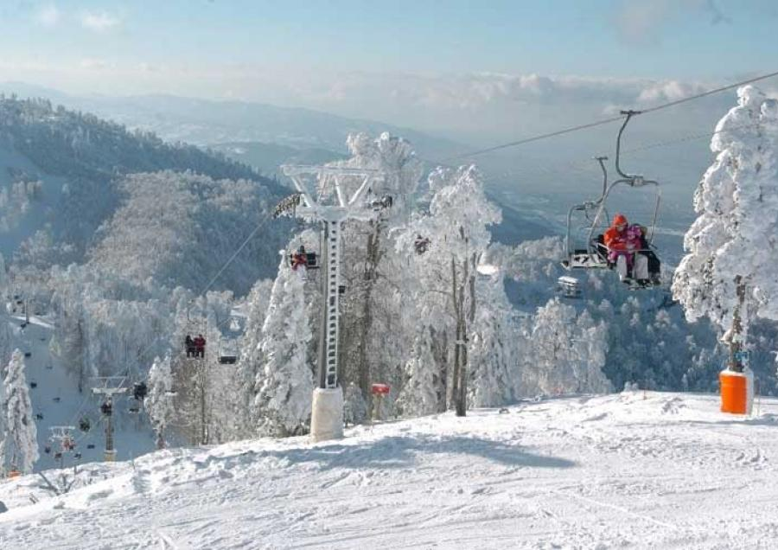
Kocaeli/ Kartepe
There are many other activities that can be done in Kartepe, which dazzles with its natural beauties. You can leave with wonderful memories from Kartepe, which provides many activities such as hiking, paragliding, horse riding, paintball, bird watching and mountain biking.

Slide 4
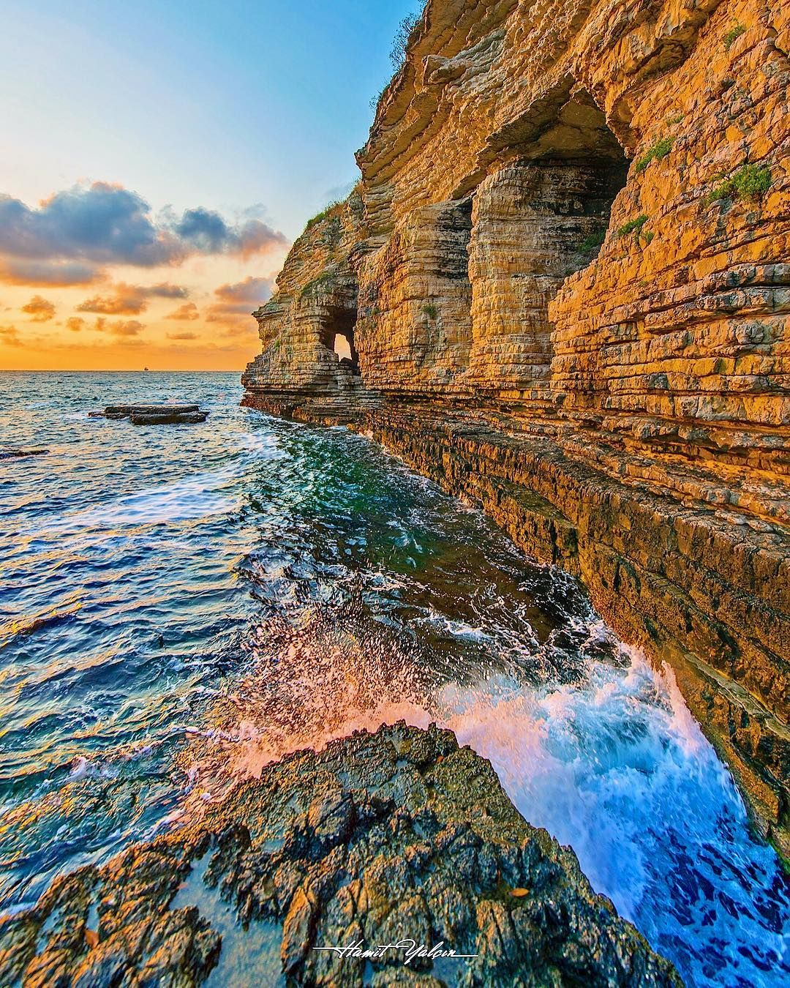
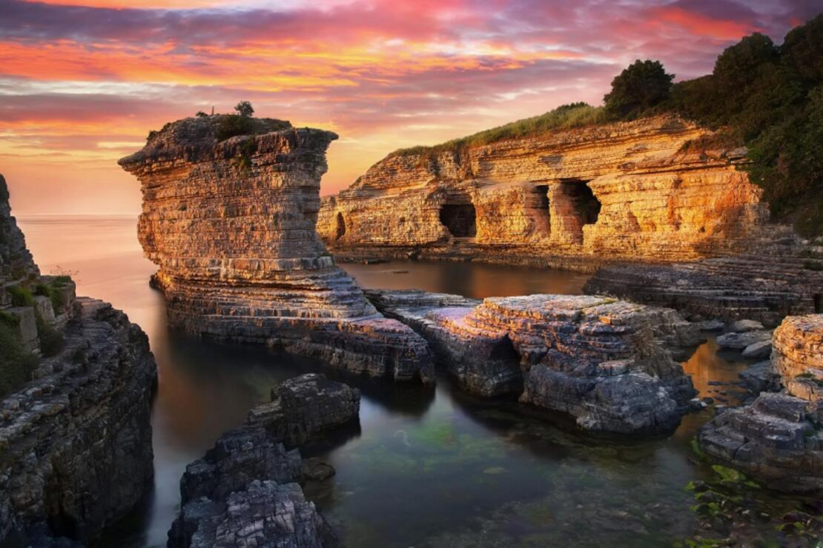
Kocaeli/Kandıra Pink Rocks
Pink Rocks is one of the must-see places with its interesting geological structure. Besides the existence of prehistoric finds, it has been used as a quarry since Antiquity. The soft pink rocks in the water harden after being removed. Because of these features, they were cut into rectangles in the Ottoman Period, transported to Istanbul by sea and used in architecture.

Slide 5
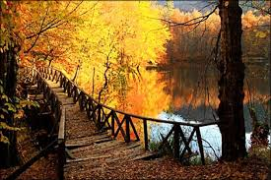
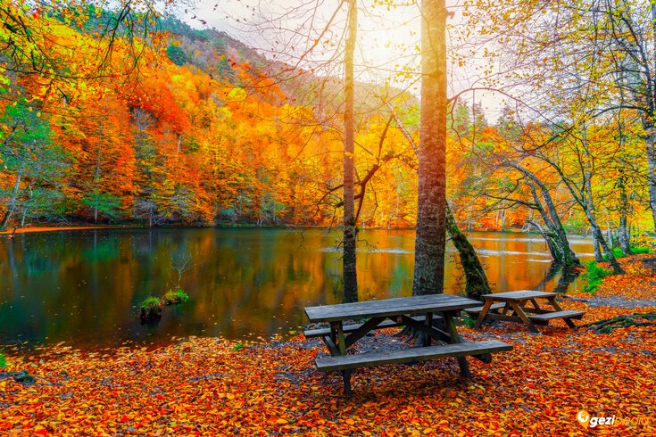
Bolu/ Yedigöller
The 1642-hectare Yedigöller Basin was protected as a national park in 1965. The basin is formed as a result of sliding masses blocking the valleys, Connected with surface and underground flows, 1500 m from north to south. It consists of 7 lakes lined up at a distance. From the remains belonging to the new Byzantine period in the "Köyyeri" area in the national park, It is understood that the region was a settlement in ancient times. Yedigöller National Park also has a strong infrastructure for scientific studies and research. The national park, which contains many plant species, has the most beautiful mixed natural forests of our country.

Slide 6
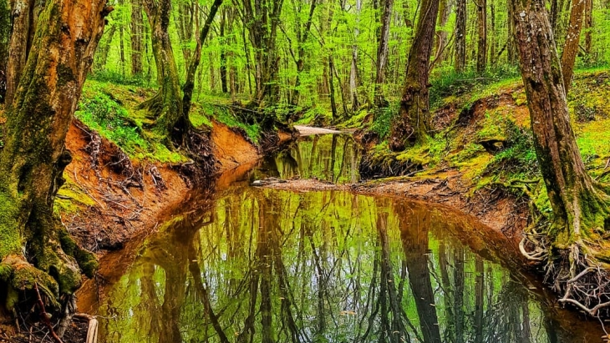
İğneada- Longoz Forests
The fauna of the national park consists of mammals, birds, insects, reptiles and amphibians. İğneada high species diversity of mammals and the environment, 34% of those in Thrace in Turkey constitute 57% of mammals. 41 mammal species have been identified in the National Park, except for bat species. In the field; Important wild species such as deer, roe deer, wild boar, wolf, fox, jackal, wild cat, marten, badger and otters, which are considered as indicators of clean waters, live. Turkey constitutes the presence of 454 bird species of birds can be seen in İğneada'da year close to half

Slide 7
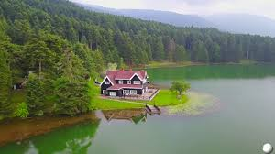
Bolu-Gölcük Nature Park
It is an artificially made set lake 13 kilometers south of Bolu city center. The surface of the lake, which is 1217 meters high, is 4.5 hectares and its circumference is approximately 1300 meters. The lake, surrounded by pine, fir, beech, hornbeam and mixed species of trees, has a magnificent view in all seasons. On the edge of the lake, which is covered with the extraordinary beauty of nature, there is a cute building, which is the "State Guesthouse" of the Ministry of Agriculture and Forestry. Gölcük Nature Park is one of the most important touristic centers of Bolu, which is heavily influenced by visitors to visit, see, relax, take photos, sport angling, bicycle tour and picnic at certain times of the year.

Slide 8
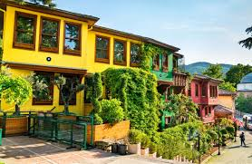
Bursa- Cumalıkızık
Cumalıkızık houses bear the characteristics of Ottoman Turkish architecture. Generally, two or three-storey houses are entered through the courtyard with a two-winged wooden door from the street. The floor of the courtyard is made of earth or stone. The low ceiling mezzanine floor is the winter part of the house and the second floor with the high ceiling is the summer part. Life and sofa are directed to climate and scenery. Traditional stone material with wooden beams on the ground floors of the houses, adobe material between the wooden roofs on the upper floors, and a wooden material with a hipped roof covered with Turkish style tiles is dominant on the roof. Its walls are usually yellow, blue, white, purple and green. On the ground floor of the houses, there are no windows opening to the outside for privacy. The windows are in the empty room.

Slide 9
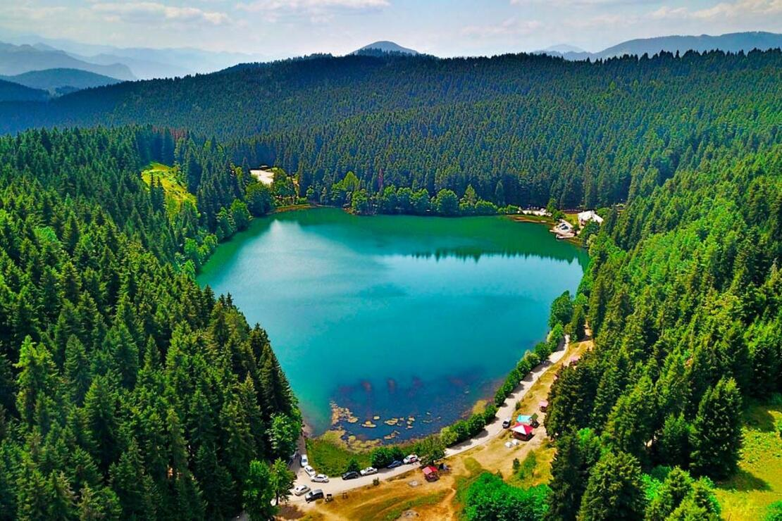
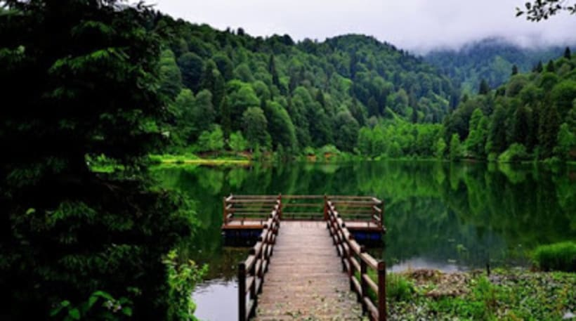
Artvin- Karagöl
If the name "nature museum in the north" is used for the Black Sea, we would fully support it. Especially the Eastern Black Sea Region has another magic in this regard. The endless plateaus, the waterfall loudly, Trabzon, Rize, Artvin… The three words that define Karagöl are Greenness, naturalness and miracle!

